Slide 1
Aeone (Laurie) Song
11th grade Vincentian Academy, Pittsburgh PA

Slide 2
Does Air Quality affect
Cancer Mortality Rates?:
PM2.5 and O3 Trends Across US Counties

Slide 3
Background and Purpose
Long-term exposure to fine particulate matter (PM2.5) has been well known as a strong risk factor of all-cause mortality^{1–3}.
To understand how air pollutants affect our health beyond respiratory system, we tested the association of regional trends in PM2.5 levels and cancer mortality rates from 2000 to 2014 across counties in the US.

Slide 4
Hypothesis
Air quality measured as PM2.5 and O3 levels changes over years and the trend differs across the nation.
PM2.5 and O3 air quality trends are associated with all types of cancer as well as lung cancer mortality trends over years.

Slide 5
Methods
Two hundred twenty eight core-based statistical areas (CBSA) across the nation with air quality trend data publicly available from US environmental protection agency (EPA) have been reviewed for weighted annual means of PM2.5 level from 2000 to 2014.
The regional PM2.5 level trends were compared with mortality rate trends of cancer in general and tracheal, bronchus, and lung cancer archived in Global health data exchange (GHDx) for the counties matched to CBSA over the same time period based on Spearman's correlation analysis.
To compare with other pollutants, we also analyzed the regional O₃ level trends in 188 CBSA with the same mortality rate trends.

Slide 6
Results
Between 2000 and 2014, the regional PM2.5 levels decreased across all 228 counties by 4.39 μg/m³on average while deaths from lung cancer and any cancer decreased by 10.56 and 22.04 per capita deaths/10⁵, respectively.
During the same period, O₃ level decreased across 188 counties by 0.015 units on average.
Changes in regional PM2.5 and O₃ levels are significantly associated with mortality rates of lung cancer in the same regions (r²=0.14 and 0.15, respectively; P<0.05) not with mortality rates of any cancer in general.

Slide 7
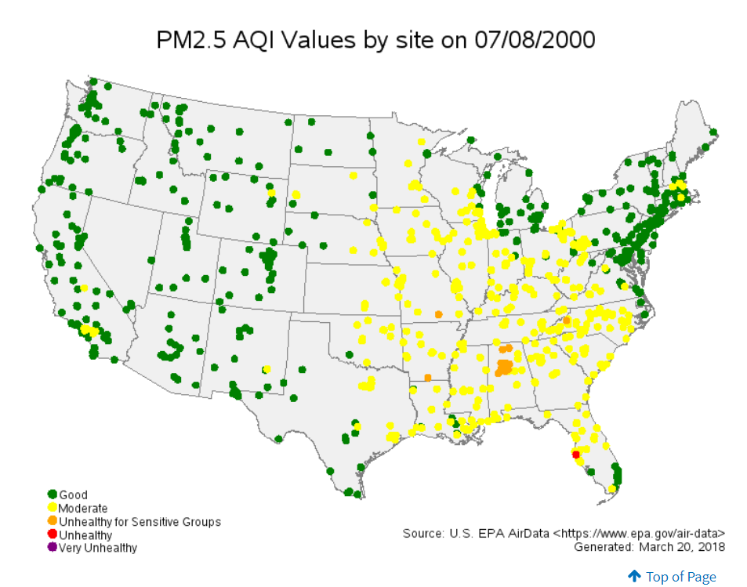
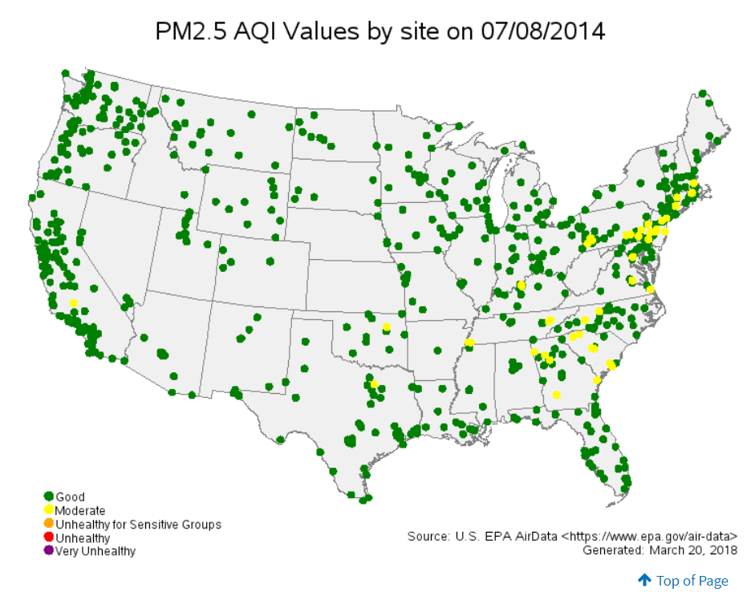
EPA Air Concentration Map for Particulate Matter (PM) 2.5
Across CBSA (Core Based Statistical Areas)

Slide 8
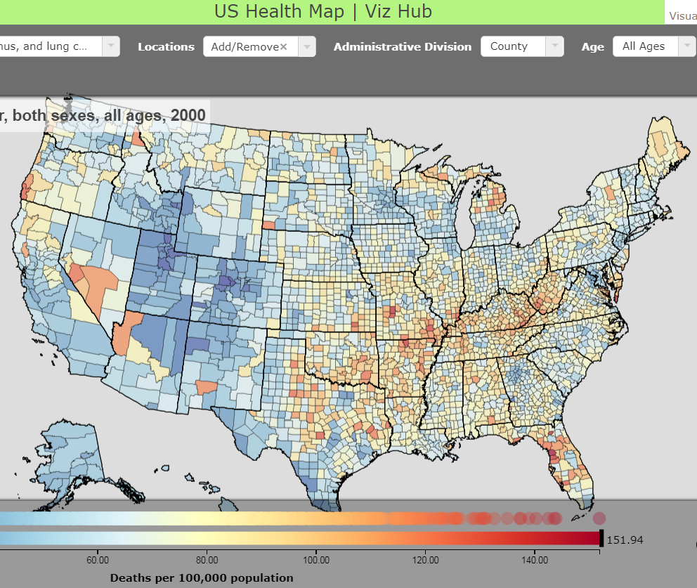
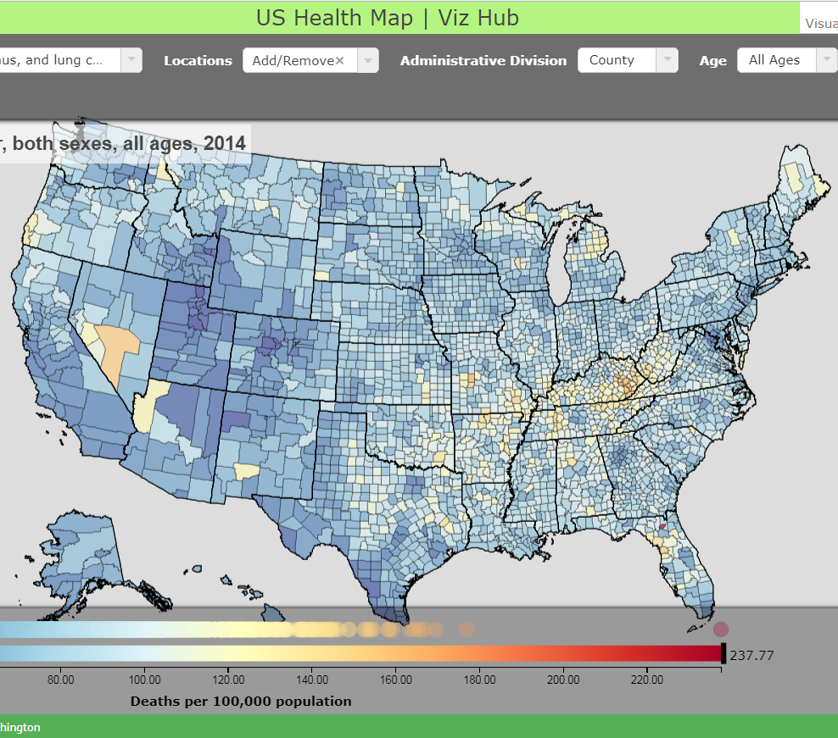
US Health Map for Lung Cancer Mortality
Across Counties

Slide 9
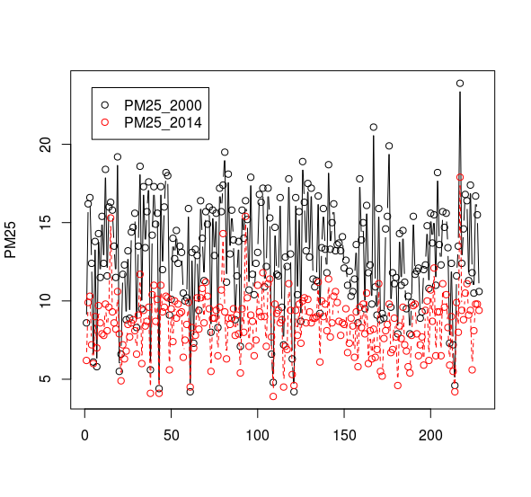
PM2.5 Trend 2000-2014

Slide 10
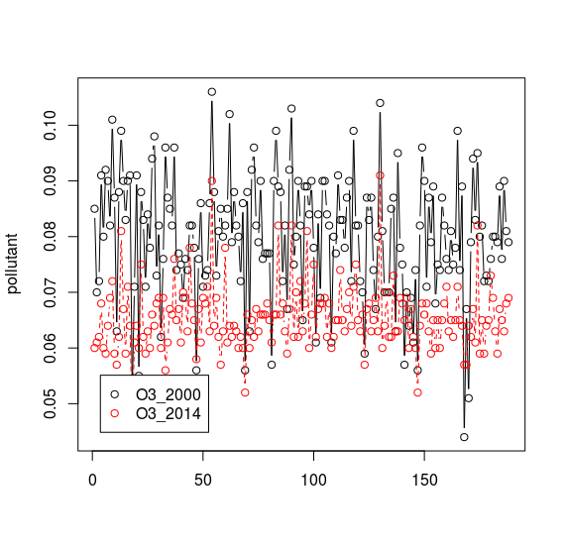
O3 Trend 2000-2914

Slide 11
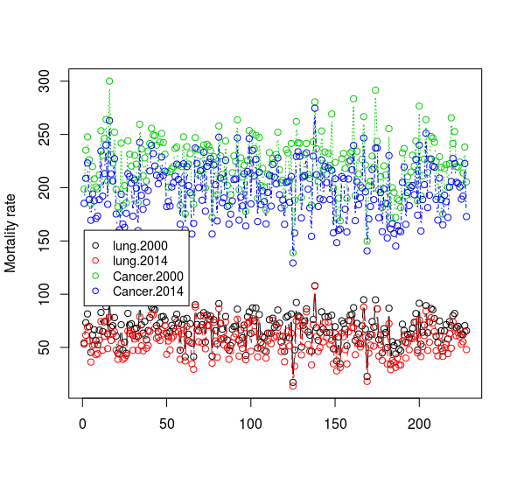
Cancer Mortality Rates 2000-2014

Slide 12
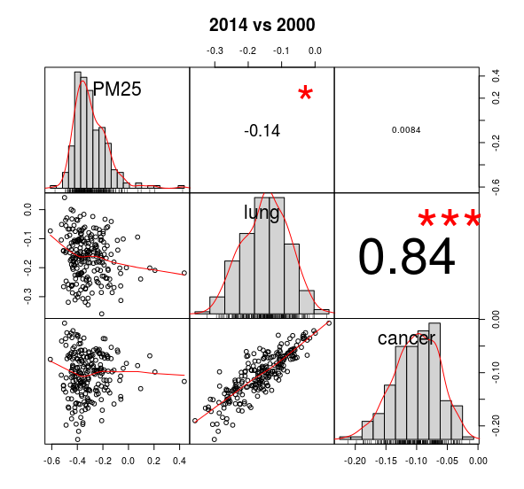
Correlation PM2.5-Lung Cancer-Any Cancer

Slide 13
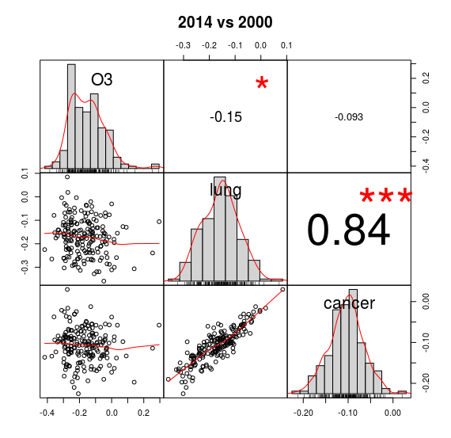
Correlation O3-Lung Cancer-Any Cancer

Slide 14
Conclusion
Air quality measured by PM2.5 and O3 levels has improved across US since 2000.
PM2.5 and O3 air quality trends are significantly associated with lung cancer mortality trends over years.
Although other types of cancer are not significantly associated with air quality, there is a linear association between cancer in general and lung cancer mortality, which is associated with air quality in this study.
Further multivariate analysis studies are warranted to confirm our results.

Slide 15
References
Cancer Mortality Data
http://ghdx.healthdata.org/us-data
Regional trends in PM2.5 air quality
https://www.epa.gov/air-trends/air-quality-cities-and-counties
Trend Analysis
https://pubs.usgs.gov/twri/twri4a3/pdf/chapter12.pdf
1. Beelen R, Hoek G, van den Brandt PA, et al: Long-term effects of traffic-related air pollution on mortality in a Dutch cohort (NLCS-AIR study). Environ Health Perspect 116:196–202, 2008
2. Krewski D, Rainham D: Ambient air pollution and population health: overview. J Toxicol Environ Health A 70:275–283, 2007
3. Pope CA, Burnett RT, Thun MJ, et al: Lung cancer, cardiopulmonary mortality, and long-term exposure to fine particulate air pollution. [Internet]. JAMA 287:1132–41, 2002Available from: http://www.pubmedcentral.nih.gov/articlerender.fcgi?artid=4037163&tool=pmcentrez&rendertype=abstract

Slide 16
Does Air

Slide 17
Quality
Affect

Slide 18
Cancer
Mortali

Slide 19
lity

Slide 20
Rates?:

