Slide 1
Modeling in Neuroscience

Slide 2
Who am I?
Michelle Miller
Graduated with ScB in Astrophysics from Brown University
Enrolled in part-time distant masters in Accelerator Physics through Indiana U – US Particle Accelerator School
Switching fields and now I’m working full time in a neuroscience lab at Columbia
I’ve done research in a variety of subfields in physics including astrophysics, particle physics, accelerator physics and now neurophysics!

Slide 3
What this course IS (vs. what it is NOT)
This will not be a complete coverage of neuroscience – that can be done for a later course if anyone is interested
Rather the focus will be
To build or review a foundation of basic structures
To develop the mathematical tools needed to analyze these structures
Then begin understanding mathematical models used to describe these phenomena

Slide 4
Prior knowledge?
Mathematics – I am assuming knowledge of calculus ;
Programming will not be required but there will be opportunity to apply coding knowledge if you have it already

Slide 5
What is computational neuroscience?
Trying to explain how the brain generates behaviors in computational terms
Characterizing WHAT nervous systems do
Determining HOW they function
Understanding WHY they operate in particular ways
Highly inter-disciplinary field
Technically began in the early 20th century
Began to identify the model for a neuron in the 50’s

Slide 6
Why build models?
Mostly for predictive purposes
Most models are developed to explain and/or to predict experimental observations.
We need to keep in mind though... Models are limited!

Slide 7
3 Types of computational models
Descriptive –
We care less about what is happening in between → we want to know what goes in and what comes out
In the case of neuroscience, this often means building a relationship between stimulus and the neuronal responses

Slide 8
Descriptive Models
Encoding
A stimulus as the input
The neural response is the output
Decoding

Slide 9
3 Types of computational models
Mechanistic -
We try to describe the physiological and anatomical features, and then try to reproduce observed behaviors by appropriate choices of parameters

Slide 10
3 Types of computational models
Interpretive (WHY) –
Why do brain circuit operate the way that they do?
What are the computational principle underlying their operations
What are the computational advantages?

Slide 11
Neural vs Digital
Device count:
Human brain 1e11 neurons (each neuron 1e4 connections)
Silicon chip 1e10 transistors with sparse connections
Device speed
Biology 100microsecond temporal resolution
Digital circuits approaching 100ps
Computing paradigm
Brain is massively parallel in computation and adaptive connections
Computers are generally sequential processing via CPU connectivity
Capabilities
Brains better at solving ill-posed problems (speech, vision, etc)
Computers excel at quantitative analysis

Slide 12
Computational Analogies
Information storage:
Physical/chemical structure of neurons/synapses
Information transmission
Electrical and chemical signaling
Computing elements
neurons
Computational basis
Research is trying to figure it out!

Slide 13
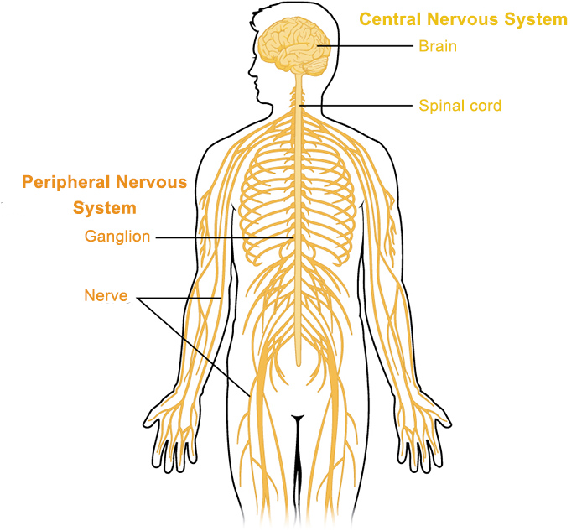
Let’s talk the nervous system…
Peripheral nervous system
Somatic
Autonomic
Central Nervous system
Brain
Spinal chord

Slide 14
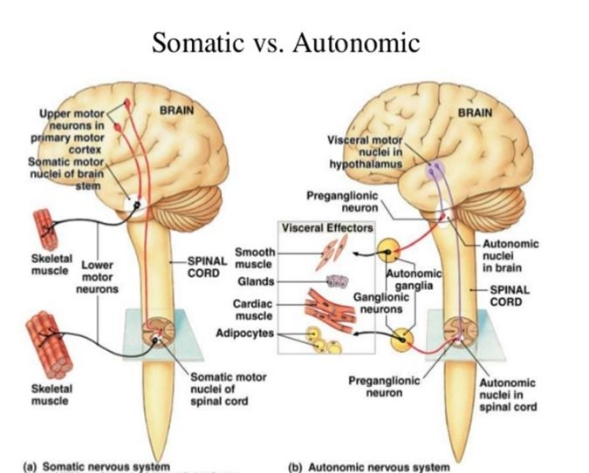
Peripheral nervous system
Somatic Nervous System – nerves connecting to voluntary skeletal and sensory receptors
Afferent nerve fibers (incoming) – axons that carry info away from the periphery to CNS
Efferent nerve fibers (outgoing) – axons that carry info toward the periphery from the CNS

Slide 15
Peripheral nervous system
Autonomic – nerves that connect to the heart, blood vessels, smooth muscles, and glands

Slide 16
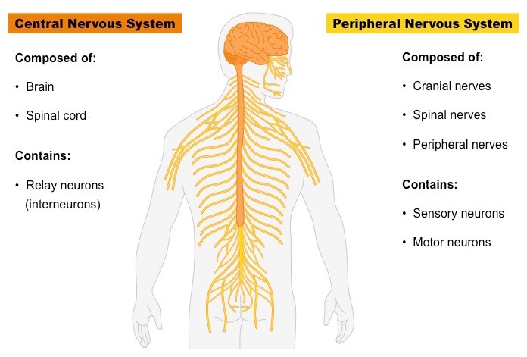
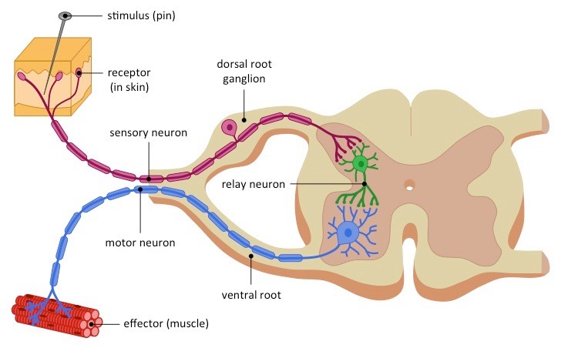
Central nervous system – Spinal Cord
Reflex Arc – local feedback loops control reflexes
Descending motor control signals coming from the brain activate spinal motor neurons
Ascending sensory axons convey sensory information from muscles and skin back to the brain

Slide 17
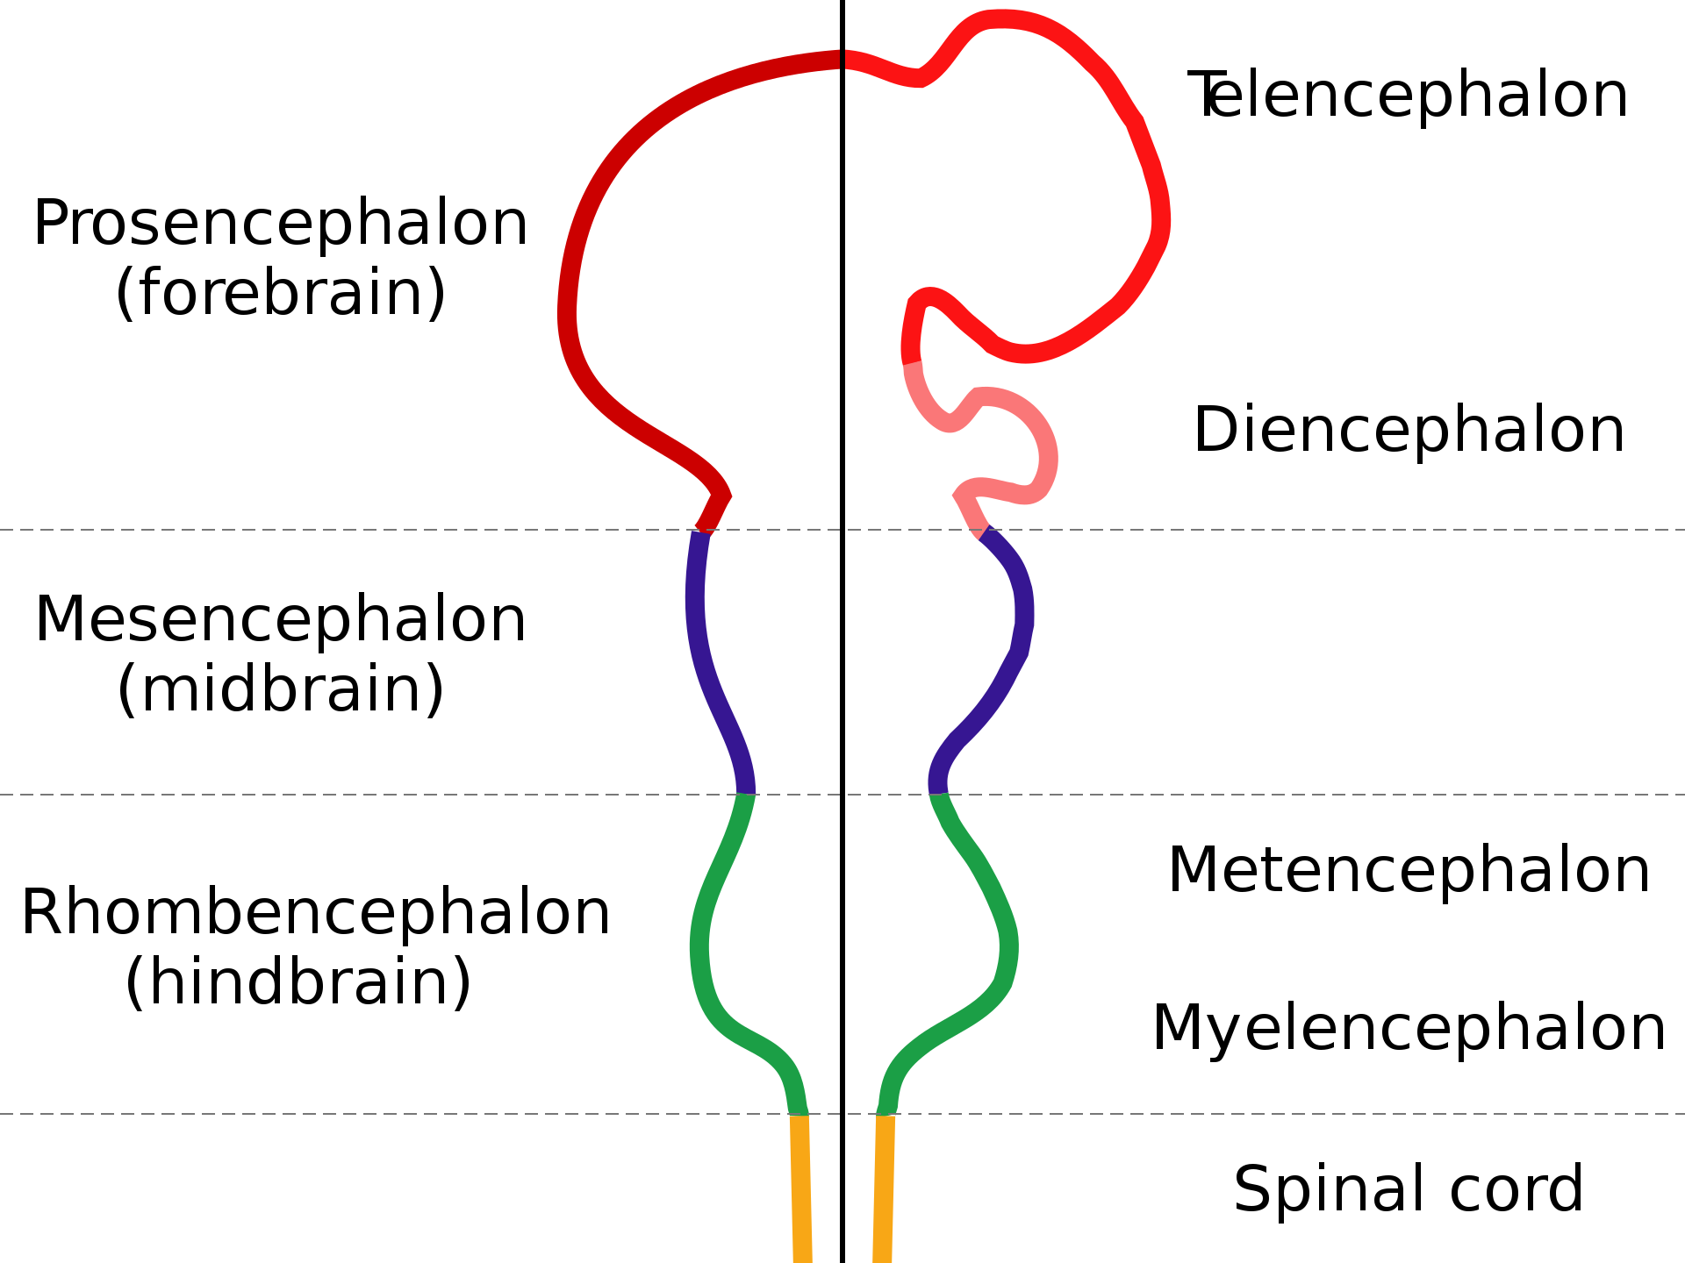
Central nervous system – THE BRAIN

Slide 18
Hindbrain
Medulla Oblongata :controls breathing, muscle tone, and blood pressure
Pons : connected to the cerebellum and involved in sleep and arousal
Cerebellum : coordination and timing of voluntary movements, sense of equilibrium, language, and attention

Slide 19
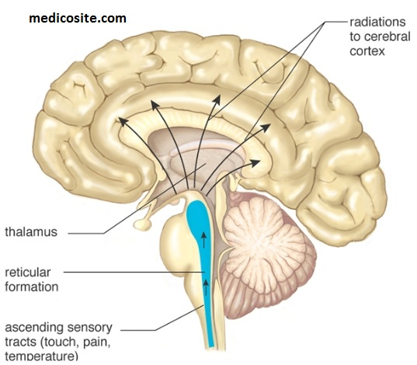
Midbrain and Reticular Formation
Midbrain – eye movements, visual, and auditory reflexes
Reticular formation – modulates muscle reflexes, breathing and pain perception. Also regulates sleep, wakefulness, and arousal
Thalamus - “relay station” for all sensory info (except smell) to the cortex, regulates sleep/wakefulness
Hypothalamus – Regulates basic needs: fighting, fleeing, feeding and mating

Slide 20
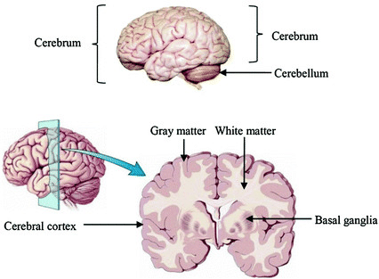
The Cerebrum
Consists of : cerebral cortex, basal ganglia, hippocampus, and amygdala
Key in perception and motor control, cognitive functions, emotion, memory, and learning

Slide 21
The Cerebrum – cerebral cortex
Cerebral cortex: layered sheet of neurons about 1/8th of an inch thick
~30 billion neurons
Each neuron makes about 10,000 synapses which means 300 trillion connections
Six layers of neurons
Relatively uniform in structure

Slide 22
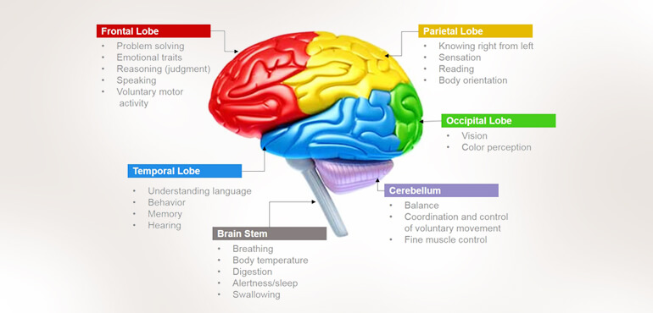
The Cerebrum – cerebral cortex

Slide 23
Homework : Choice 1
Pick one region of the brain which we have discussed today
Write two sentences about it’s purpose
Write two sentences about how it communicates with other parts of the brain
Do a little research on disorders within your chosen region of the brain – answer each of the following questions
What is the problem that results in this disorder?
What are the symptoms?

Slide 24
Homework : Choice 2
Write a programming script which produces a sequence of numbers – many of which are zero and nonzero
(these numbers can either be saved in a text file or an array)
Read in these numbers, count the total number of nonzero elements
If each “entry” in the original array is a time step forward, what was the average number of nonzero elements per time step? (Also write the code for this)

Slide 25
The Neuron
Neuron doctrine:
the neuron is the fundamental structural and functional unit of the brain
Neurons are discrete cells and not continuous with other cells
Information flows from dendrites to the axon via the cell body

Slide 26
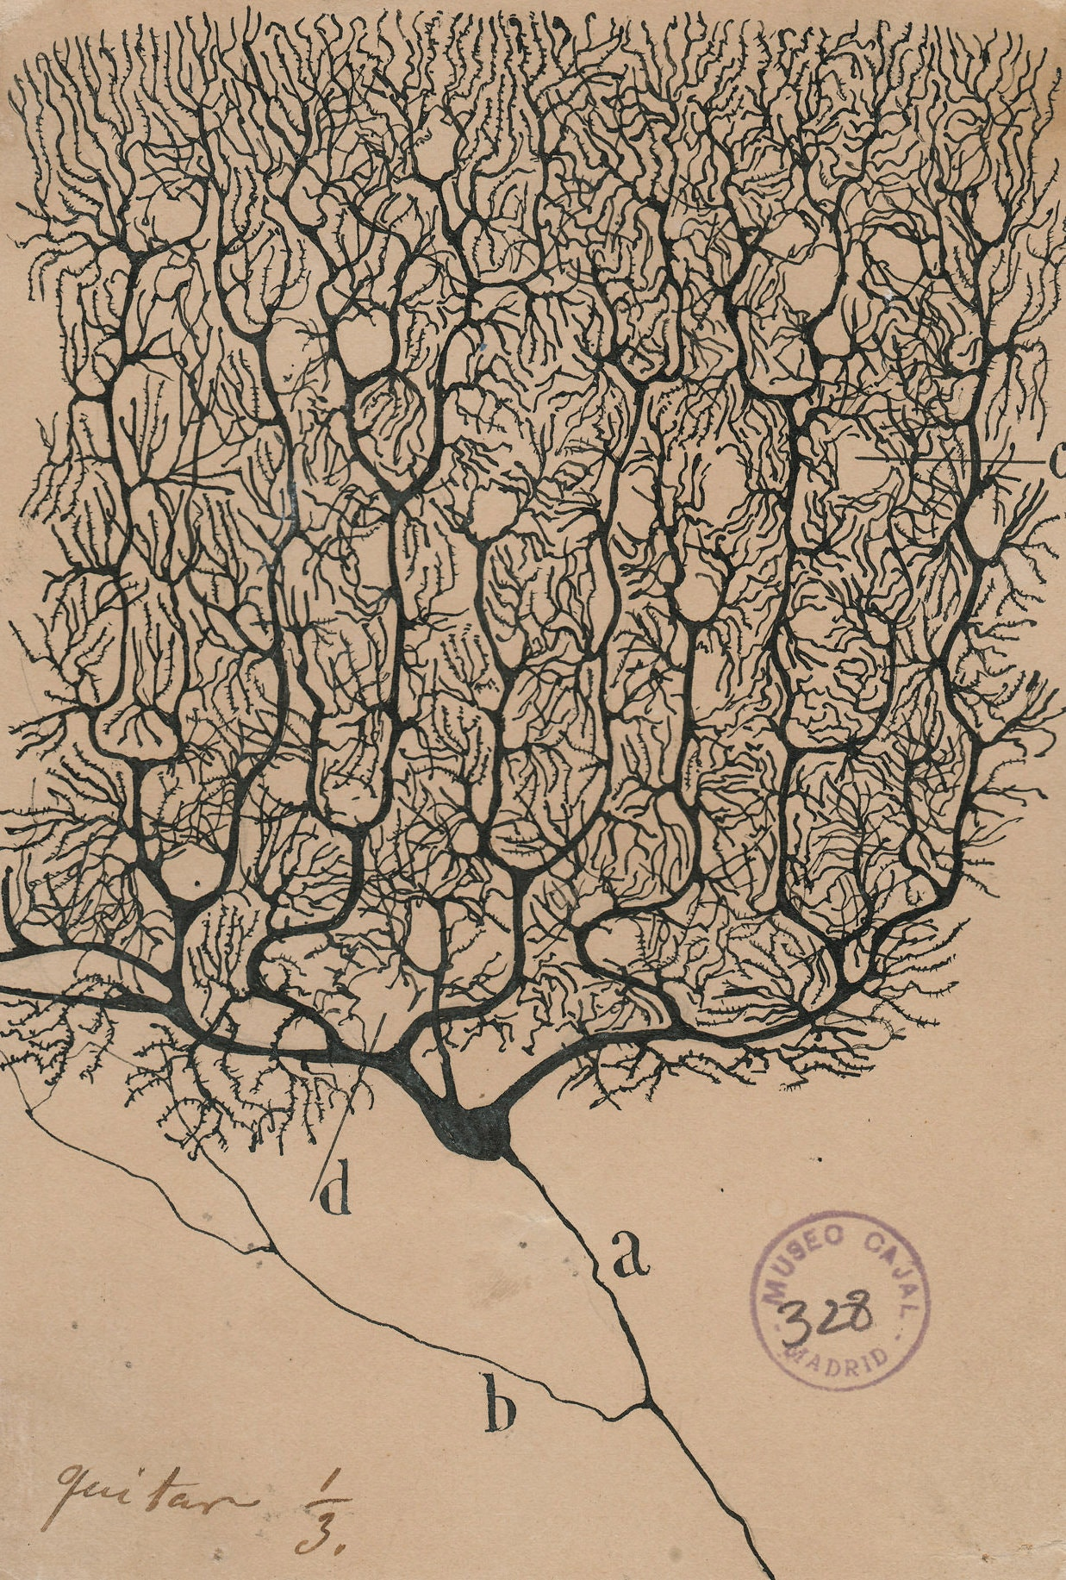
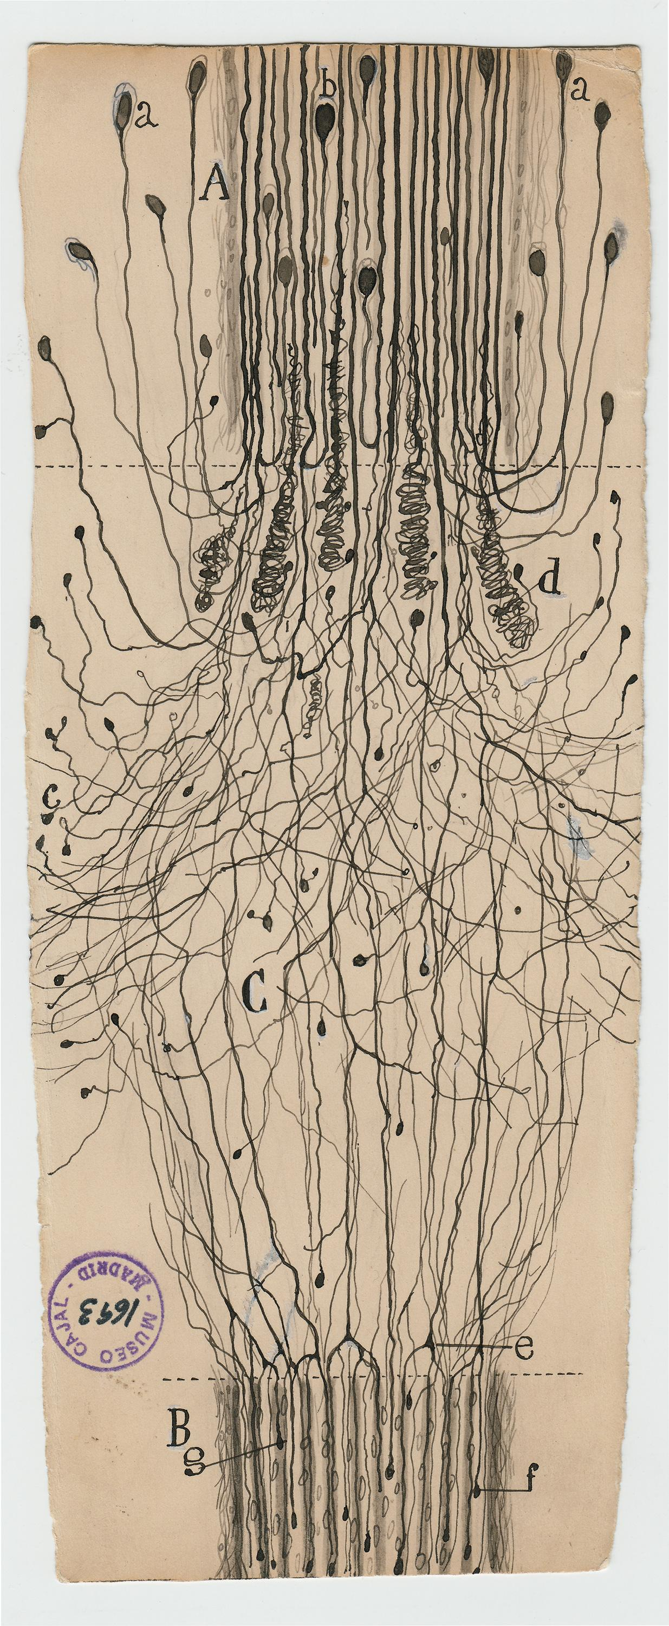
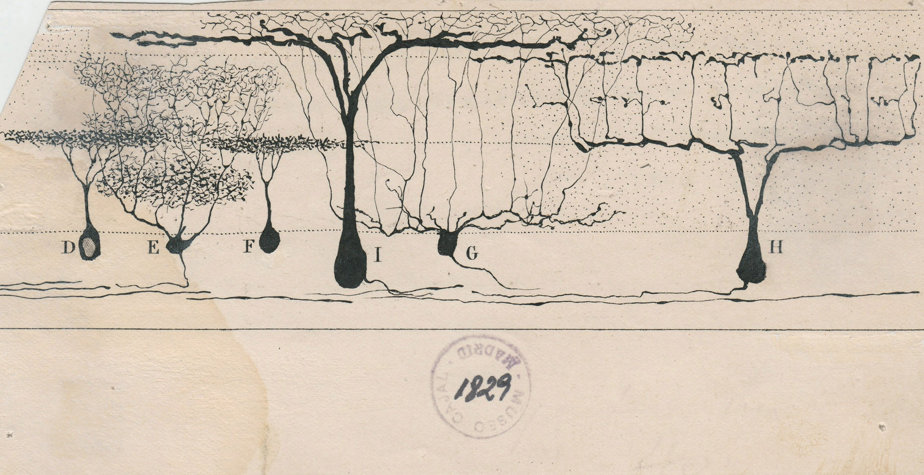
Wide variety of neurons
From the retina of a lizard (1911)
Neuron in the cerebellum (1899)
Nerve cell outside the spinal cord (1913)
Images drawn by Spanish neuroscientist in late 1800’s early 1900’s

Slide 27
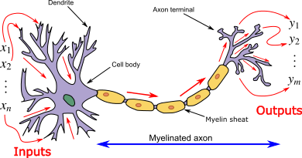
Idealized model
Inputs come from axons of other neurons
Each input is an excitatory post-synaptic potential
A dendrite will receive a summation of the EPSPs from the many cells connecting to the neruon
If these have a strong enough signal then they will produce an action potential → we will refer to these action potentials as spikes

Slide 28
Idealized model
Neurons are basically leaky bags of charged liquid
Contained by phospholipid bilayer (cell membrane)
The bilayer is impermeable and encloses the charged particles Na+, K+, Cll+
There are ionic channels and gated channels inside the membrane – they allow the ions to flow inside
There is an electrical potential difference across the membrane – the inside is about -70mV relative to the outside - this is a rest potential

Slide 29
Electrical potential
This -70mV potential exists because there is more Na+ and Cl- outside ; K+ and organic anions A- higher inside
Ionic pump expels sodium outside and allows potassium inside – this takes energy
A lot of energy is meant to maintain this difference
How does an electrical potential change?
Ionic channels – embedded in the membrane are selective proteins and only allow specific ions through
They are gated
Voltage gated- probability of opening depends on membrane voltage
Chemically gated- binding to a chemical causes channel to open (synapses are examples)
Mechanically gated – sensitive to pressure or stretching

Slide 30
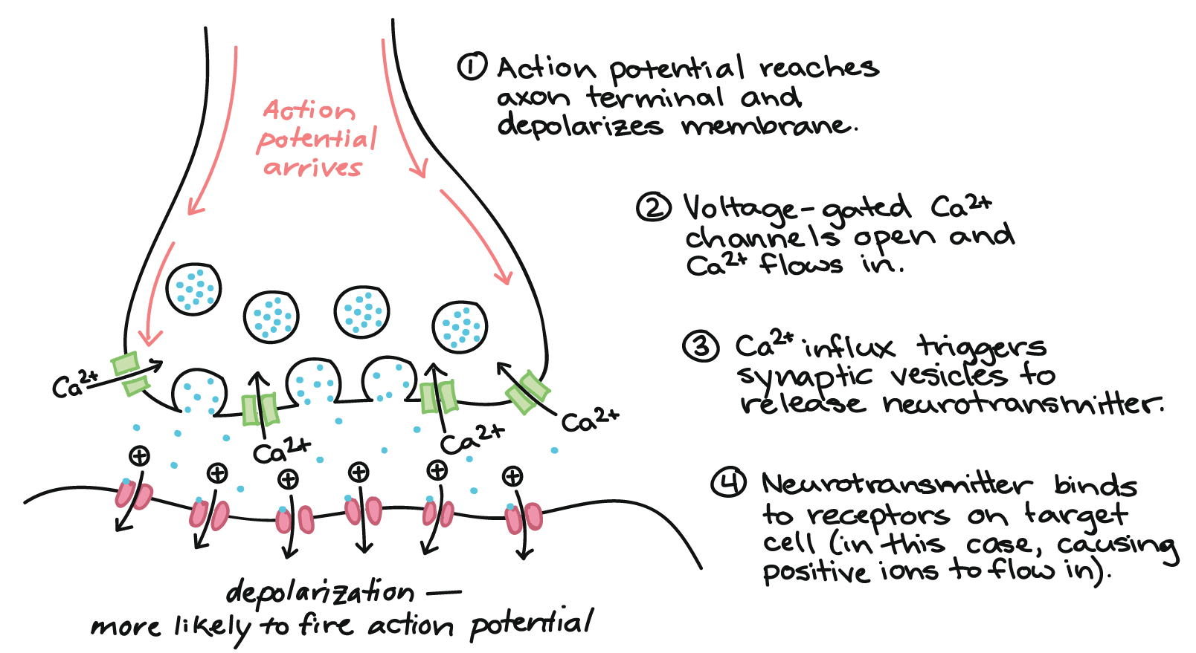
Neuronal Signaling via Gated Channels

Slide 31
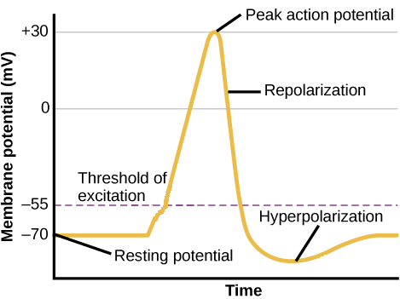
Neuronal Signaling via Gated Channels
Inputs from neurons as action potential reaches the synapse
Neurotransmitters released via vesicles → chemically gated at synapses, which are junctions between neurons will open
Sodium gated channels will open and sodium to go from outside to inside→ causes increase in local membrane potential
The influx in sodium causes change in potential → voltage gated channels will then open/close and either result in depolarization by allowing as positive change in the cell or a hyperpolarization
Hyperpolarization: The potassium channels may open so the potassium ions to diffuse out and there will be a negative change in the voltage
Depolarization : If there is strong enough excitation– then an action potential can be triggered`

Slide 32
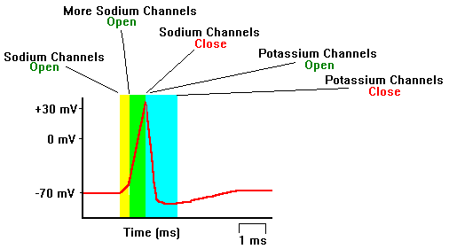
Electrical potential
A strong depolarization is called a “spike”
Voltage-gated channels cause action potential
Strong depolarization occurs from Na+ channels opening
Causing rapid Na+ influx and more channels to open until they inactivate due to the change of potential
Then voltage gated K+ outflux restores membrane potential in a hyperpolarization process
https://www.youtube.com/watch?v=liPWjnpEl_M
https://psych.hanover.edu/Krantz/neural/actpotanim.html

Slide 33
Return to structure: myelination
Oligodendrocytes (glial cells) wrap around axons and enable fast long-range spike communication
Saltatory conduction : action potentials are able to jump between nodes of Ranvier
Allows for lossless signal propagation
MS – autoimmune disorder causing the breakdown of the myelin ; cells lose ability to propagate signals in a fast and robust manner

Slide 34
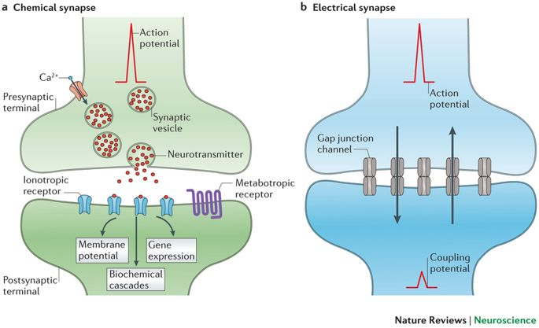
Types of Synapses
Chemical – facilitated by neurotransmitters
Allows the neuron to change how it responds to the same signal
Electrical → chemical → electrical
Can allow for customized amount of current transmission desired between neurons upon spiking, such as in building memories.
Electrical - they use gap junctions and are facilitated by ions; excitations on one side of a synapse can result in movement of ions between neurons
Very useful for synchronization

Slide 35
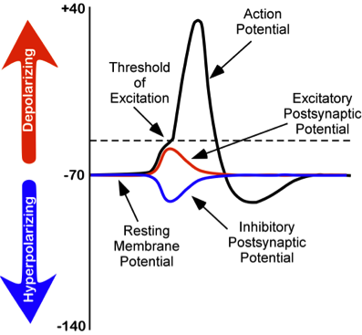
Excitatory vs Inhibitory
Excitatory – will increase the membrane potential → action potential in post-synaptic neuron is excited
Neurotransmitters include: epinephrine, norepinephrine, glutamate
Inhibitory – will decrease the membrane potential → action potential inhibited
Neurotransmitters include: serotonin, gamma-aminobutyric acid (GABA),
Note: not all neurotransmitters fall in either category; dopamine and acetylcholine can be both for example ;

Slide 36
Synapse Doctrine
Synapses are the basis of memory and learning

Slide 37
Synaptic (Hebbian) Plasticity
If neuron A repeatedly takes part in firing neuron B, then the synapse from A to B is strengthened
Neurons that fire together wire together
Long term potentiation (LTP) – experimentally observed increase in synapse strength that lasts for hours → increase in EPSP size
Long term depression (LTD) – experimentally observed decrease in synapse strength that lasts for hours → increase in EPSP size

